Slide 1
Previous works on transportation mode

Slide 2
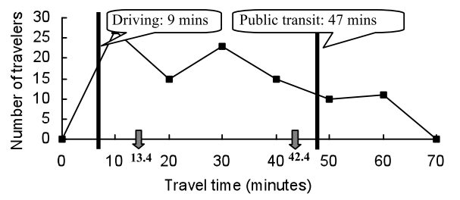
Clustering transportation mode by distribution of travel time part 1 [1]
Methodology: For a specific origin A and destination B, classify travel mode by perform kmeans on travel time.

Slide 3
Clustering transportation mode by distribution of travel time part 2 [1]
Dataset:
Middlesex county (including boston), 56K users, 9M trips, 1Month, Call records
Location error: ~300m
Preprocessing:
Focus on highly active user (frequent calls)
Focus on long trip due to coarse granularity
Evaluation:
Compare cluster center with google map estimated travel time
Silhouette value (smaller within distance, larger between distance)

Slide 4
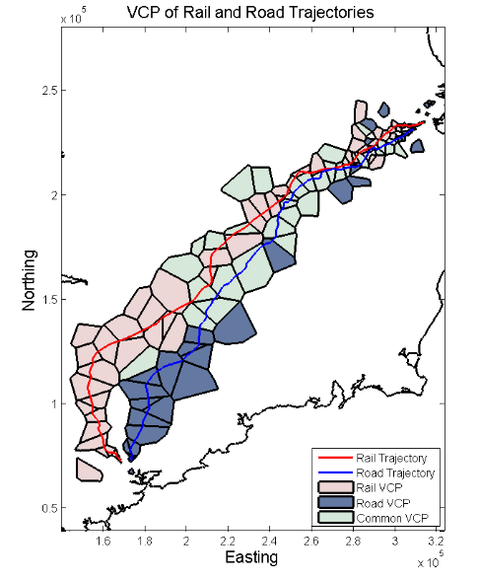
Cluster transportation mode by estimated route part 1 [2]
Methodology:
By examining the non-overlapping area of trips, estimate the path being used. Require paths does not overlap a lot and limited transportation mode (trains vs. cars)
Use kernel density estimation and Dijkstra’s algorithm to build an estimated path

Slide 5
Cluster transportation mode by estimated route part 2 [2]
Dataset:
Whole Ireland, 300M entries, 1M users, 1 week, Call records
Tower location
Preprocessing:
Focus on long trip (inter city)
Focus on continuously moving users
Evaluations:
Show clustering results
Compare estimated path with real path

Slide 6
Solve 2 core issues in transportation mode inference [3]
Methodology:
Zigzagging
Home and commuter location detection
Midnight – home
11am & second most frequently visited location - commuter
Dataset:
Whole Isreal, 10M users, 1 week, handover data
Tower location
Preprocessing:
Focus on faster mode due to accuracy issues (not try to distinguish walk/bike)
Evaluations:
Compare statistics with survey (home location vs. population distribution)

Slide 7
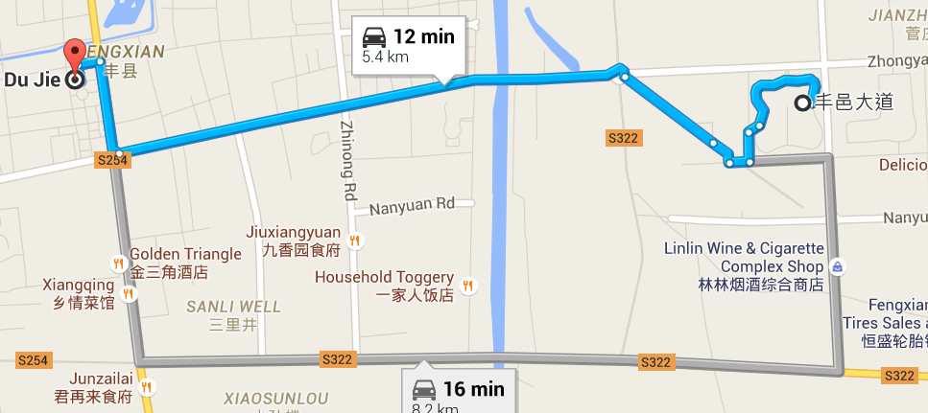
Apply method in first paper to our dataset part 1
Specific location:
Orig: 34.69186, 116.63601
Dest: 34.693013, 116.592613
Trip length ~5km

Slide 8
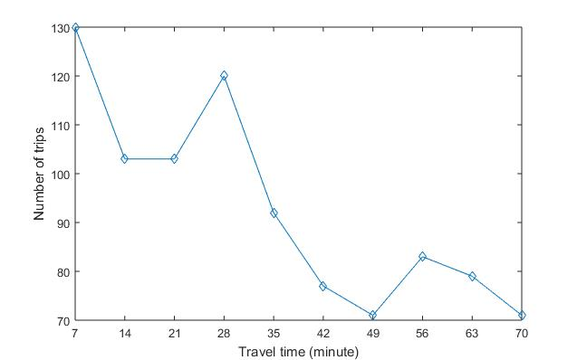
Apply method in first paper to our dataset part 2
Estimated travel time by Google Map (baseline):
Walk: 64min
Public transit: 73min (53min)
Vehicle: 12min
Estimated travel time by kmeans:
Cluster 1 (walking): 51min
Cluster 2 (driving): 17min

Slide 9
Apply method in first paper to our dataset part 2
Evaluation:
Error: (|51-64| + |17-12|)/2 = 9min (5~6min in paper 1)
Among all 929 users, 411 belongs to walking. Do people really go a place 5km far by walking?
Silhouette value: 0.7969 (0.6~0.75 in paper 1)
k = [1:10] all suggest good fit, S value > 0.7

Slide 10
Some thoughts
Develop new algorithms to calculate aggregated results rather than focus on individuals. So even without ground truth, we can compare with 3 party sources such as Google map / surveys.
Current research does not have very exciting results in inferring user’s mobility mode, which left us a lot of improvement space.

Slide 11
References
[1] Transportation mode inference from anonymized and aggregated mobile phone call detail records
[2] Utilising mobile phone billing records for travel mode discovery
[3] Investigation of travel patterns using passive cellular phone data

